Slide 1
Women’s Global Issues:
Making a Difference!
Desirée Patno
CEO & President of NAWRB
March 8th, 2018

Slide 2
Women in the Housing and Real Estate Ecosystem
A leading voice for women- Making a difference.
With the assistance of our Women’s Diversity and Inclusion Leadership Council (NDILC), NAWRB is advocating for women’s gender equality, raising the utilization of women-owned businesses and providing women the tools and opportunities for economic expansion and growth.
By increasing women’s homeownership, we can leverage the entrepreneurial strength of women and help bring the awareness of women’s poverty.

Slide 3
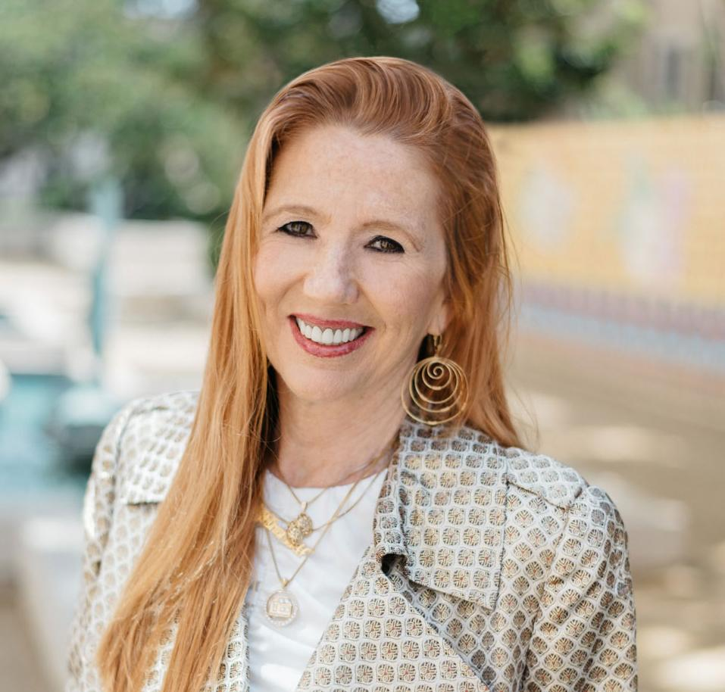
About NAWRB (cont.)
NAWRB has spoken at the 2017 International Conference on Gender and Sustainability (ICOGAS) on the margins of the 72nd United Nations Assembly, 2017 mPowering You: MBA's Summit on Women in Real Estate Finance and 2016 MBA’s Diversity and Inclusion.
Desirée Patno, NAWRB CEO & President, has been named the highest-ranking woman and 4th Overall Top Real Estate Influencer to Follow by Entrepreneur.com in 2017, and was selected as the 2016 Small Business Administration’s (SBA) Women in Business Champion of the Year.

Slide 4
Introduction
Women’s Gender Equality & Economic Sustainability
The global gender inequalities of present day are alarming, and while these imbalances may differ from country to country, they are products of pervasive gender gaps systematically holding back women and girls.
Globally, 130 million girls are out of school, 35 percent of women have been victims of physical or sexual violence and in low- and middle-income countries, 40 percent of girls are married before they turn 18.
Source: ICOGAS 2017

Slide 5
Domestic Violence & Gender Wage Gap
In the U.S., a country that is arguably well ahead of others in gender equality, women continue enduring an insidious 25 percent gender wage gap and violence against women is a menacing phenomenon
The National Coalition Against Domestic Violence (NCADV) reports
Victims of intimate partner violence lose 8 million days of paid work every year in the U.S.—the equivalent of 32,000 full-time jobs
Intimate partner violence costs the American economy between $5.8 billion and $12.6 billion annually.

Slide 6
Gender Equality Worldwide
Nordic Countries Lead the Way
The Nordic countries are scoring highest regarding gender equality in the world, according to the Global Gender Gap Report published by the World Economic Forum.
Norway was the first European country to adopt a gender quota for hiring female board members in 2004, and other countries followed suit, including Iceland, France, Germany, Italy, Sweden, and the UK.
As of 2016, only Norway and Iceland had successfully reached their quota.

Slide 7
Gender Equality Worldwide
Nordic Countries Lead the Way
Australia, Denmark, and the U.S. are among Western-developed countries where neither voluntary goals nor quotas have been set to increase female representation in corporate boards.
In the U.S., female representation in the boardrooms of the S&P 500—at 18.7 percent— has not changed significantly in the last decade, and continues to be lower than most of Europe.

Slide 8
Gender Equality Worldwide
Iceland
The world’s most gender-equal country for the past 9 years, ranked by the World Economic Forum.
Iceland became the first country to make it illegal to pay women less than men, a tour de force for gender equality in the workplace.
In 2016, women in Iceland were making 14 to 18 percent less than men.
This country is utilizing legislation to eliminate the gender pay gap after successfully closing 70 percent.

Slide 9
Gender Equality Worldwide (Cont.)
Iceland vs. United States
Iceland’s active efforts to enforce gender equality and increase opportunities for women is an inspiring example for other countries still fraught with inequity.
The United States, for example, lags behind Iceland at No. 49 for gender equality.
The nation was ranked No.45 just last year, indicating that gender inequality worsened in 2017.
According to the Pew Research Center, professional women in the United States earn 83 cents for every dollar their male counterparts earn, despite comprising more than half of the labor force

Slide 10
Global Profiles
Asia
Mercer projects that Asia will have the lowest representation of women by 2025 at only 28 percent at the professional level and above.
Organizations in this area are less likely to be focused on gender diversity than the other regions studied.
They are less likely to engage middle management to enforce gender diversity practices or engage the male population among their employees.

Slide 11
Global Profiles (Cont.)
Europe
Europe has seen improvement in female representation at top levels of employment, but this will not extend into further improvement at the professional level and above over the next decade.
In 2025, women are likely to make up 37 percent of employees at the professional level—the same as today.
Women are hired at almost double the rate of men for top positions at European organizations. This is likely impacted by quotas, regulations and pressure from the media.

Slide 12
Global Profiles (Cont.)
Latin America
Women comprise 17 percent of executives, and, if current hiring, promotion and retention rates are maintained, female representation is likely to grow to 44 percent by 2025
Latin America is on track to achieving gender parity at the professional level and above within the next ten years.
Women are more likely than men to be promoted at entry level, and twice as likely to be promoted at the senior management level

Slide 13
Global Profiles (Cont.)
U.S. & Canada
Organizations in North America have a greater percentage of women in the mid- and senior-level workforce than in any other region, and they have also seen improvements in promotion and hiring rates of women at the executive level in the past year.
This region is focused on “quick fixes” in hiring more women in senior-level positions.
Without structural practices and policies to increase gender representation at all levels of employment, there will not be enough talent flow to grow women’s representation over the next decade.

Slide 14
Global Profiles (Cont.)
Australia & New Zealand
Organizations have lower hiring and retention rates of women at the executive level, compared to their male counterparts.
Women currently make up 17 percent of executives and 33 percent of those at the professional level and above
Ranked second lowest in terms of rates of women’s representation. If this continues, women will only make up a third of top jobs in 2025.

Slide 15
Obstacles for Women’s Economic Growth
Despite earning less—women earn 80 cents for every dollar men earn—single women are outpacing single men in homeownership.
They overcome significant obstacles, such as a wage gap, a “pink tax” on hygiene products and higher lifetime medical expenses.

Slide 16
Obstacles (cont.)
Although women have lower incomes, they default less than men on mortgages but have higher mortgage rates:
Between 2004 and 2007, the default rate for female-only borrowers was 24.6 percent. For male borrowers, it was 25.4 percent
From 2008-2010 (and 2011-2014), the female default rate was again lower than the male-only rate.
Homes owned by single women are worth 10 percent less and appreciate 16 percent slower than homes owned by single men, according to RealtyTrac.

Slide 17
Obstacles (cont.)
Women’s Poverty (U.S.)
•According to 2016 Census Bureau data, 26.6 percent of families with a single female householder, with no husband present, are below the poverty level rate—twice the poverty rate of single male householders, with no wife present.
•Female householders have
–42.1 percent of the children under 18 years old in poverty
–49.1 percent of the children under 6 years of age in poverty
•Female householders makeup 51.2 percent of all families below the poverty line.

Slide 18
Obstacles (cont.)
Student Loans
According to the American Association of University Women (AAUW), women carry more student loan debt than men—almost ⅔ of the $1.3 trillion outstanding student loan debt in the U.S.
44 percent of female undergrads take on debt in a year, compared to 39 percent of male undergrads
Women take about two years longer than men to pay off their undergrad loans

Slide 19
Obstacles (cont.)
The AAUW report says that women with only bachelor degrees were “more likely than men” to report that education costs had influenced them to delay homeownership and take “a less desirable job or a job outside of their field.”

Slide 20
Projections for the Future
According to the World Economic Forum’s 2015 Global Gender Gap report, we are 118 years away from witnessing the close of the gender gap for labor market opportunity, education, health and political clout.
Mercer When Women Thrive 2017 report reveals that women make up only 35 percent of an average companies workforce, at the professional level and beyond.
Women in the labor force globally comprise 33 percent of managers, 26 percent of senior managers and 20 percent of executives.

Slide 21
Looking Forward
“Every moment is a teachable moment. Women contribute $20 trillion to the global economy; naturally we should define and implement economic goals. In the words of Kwame Nkrumah, ‘Those who would judge us merely by the heights we have achieved would do well to remember the depths from which we started.’”
- Matilda Arhin, President, Ghana International Chamber of Commerce, ICOGAS 2017 Conference
Source: ICOGAS 2017

Slide 22
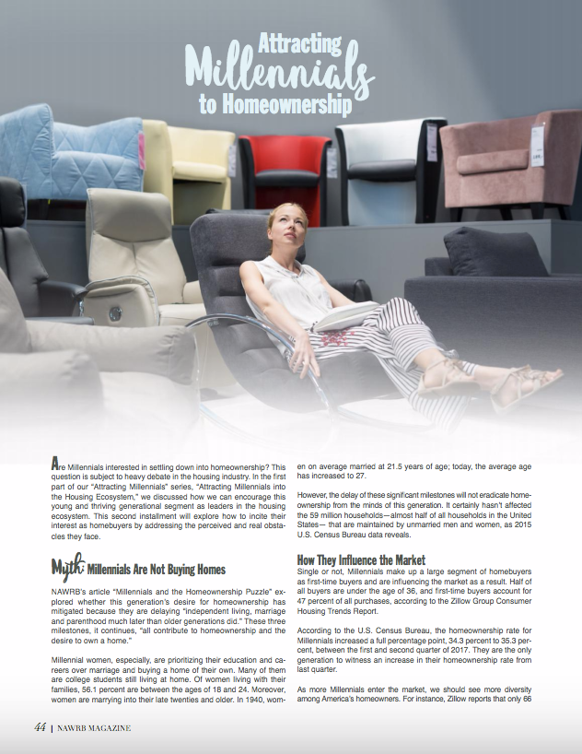
Among Millennial homeowners:
17% are Hispanic or Latino;
10% are African American; and
7% are Asian or Pacific Islander

Slide 23
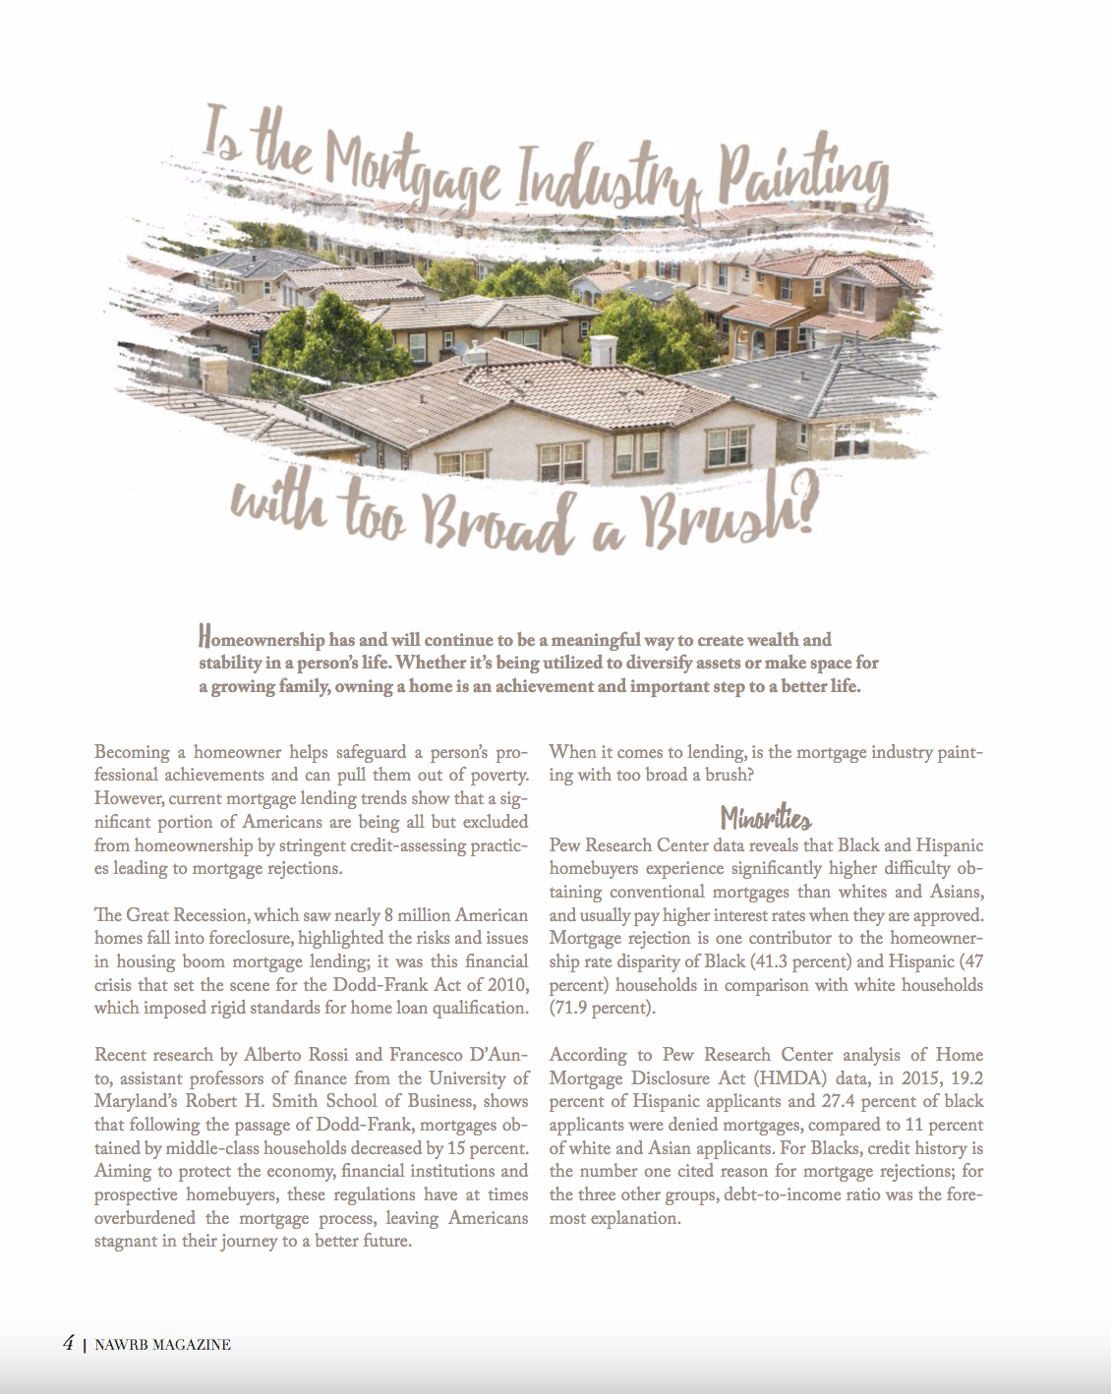
Women Homeownership
Female borrowers default less than male-only borrowers.
The default rate for female-only borrowers was 24.6%, compared with 25.4% for male-only borrowers.

Slide 24
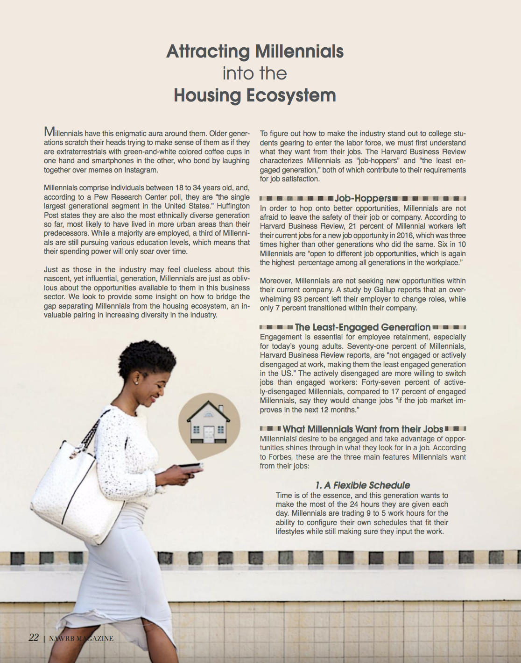
What Millennials Want from their Jobs:
1. A Flexible Schedule
2. To Be Inspired
3. Part of the Solution

Slide 25
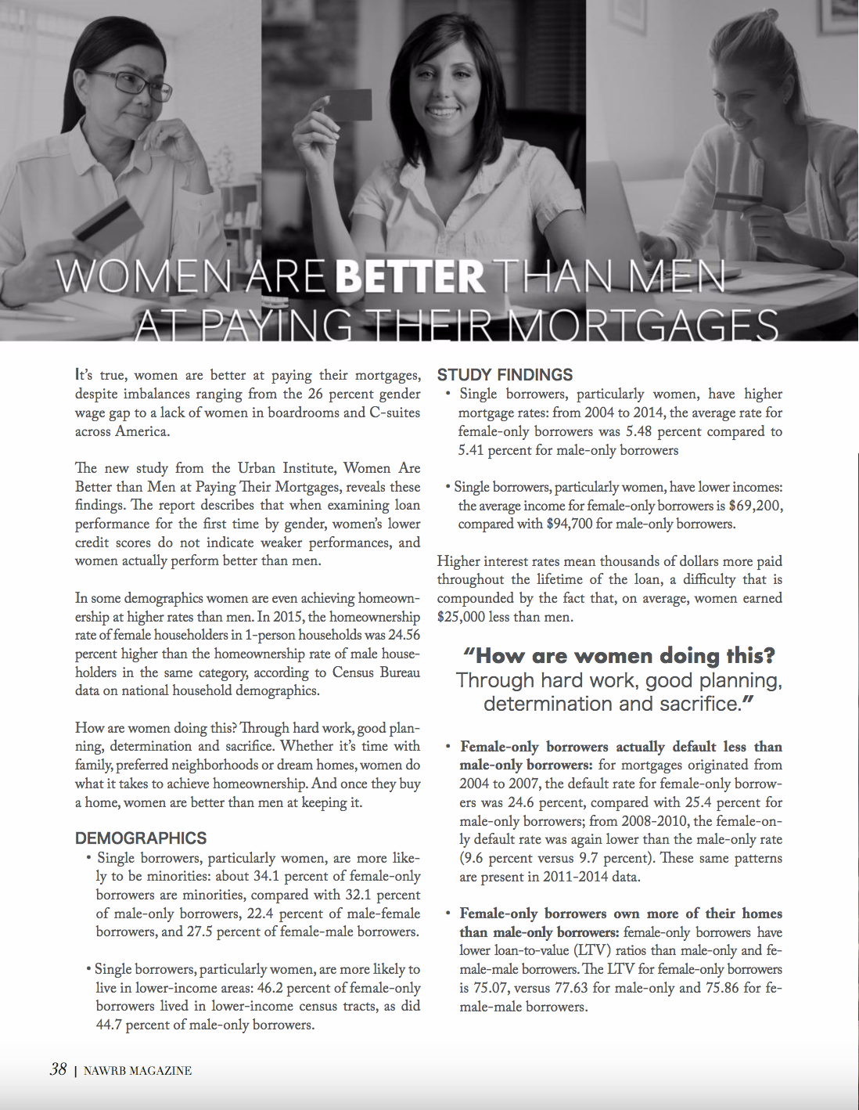
Study Findings
Single borrowers, particularly women, have higher mortgage rates: from 2004 to 2014, the average rate for female-only borrowers was 5.48% compared to 5.41% for male-only borrowers

Slide 26
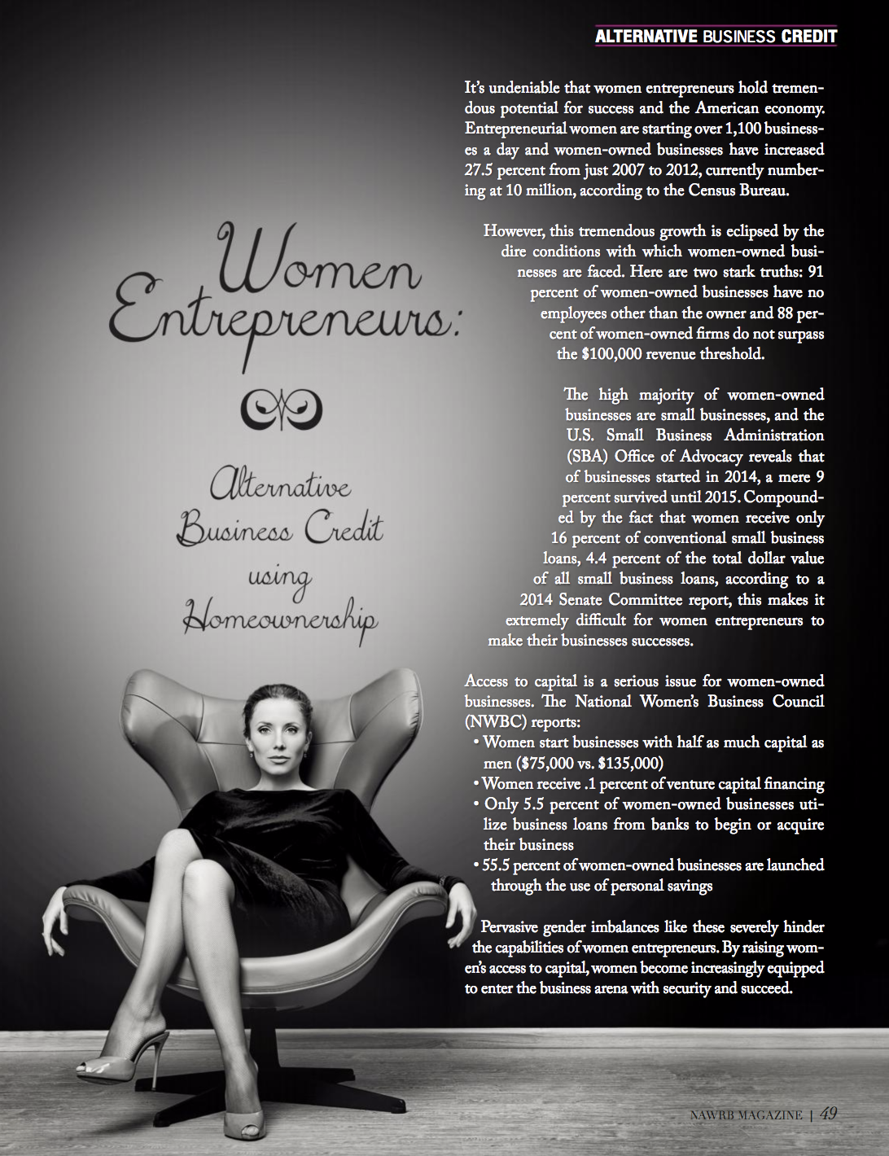
Women Entrepreneurs
Women are starting over 1,100 businesses a day
Women-owned businesses have increased 27.5% from 2007-2012

Slide 27
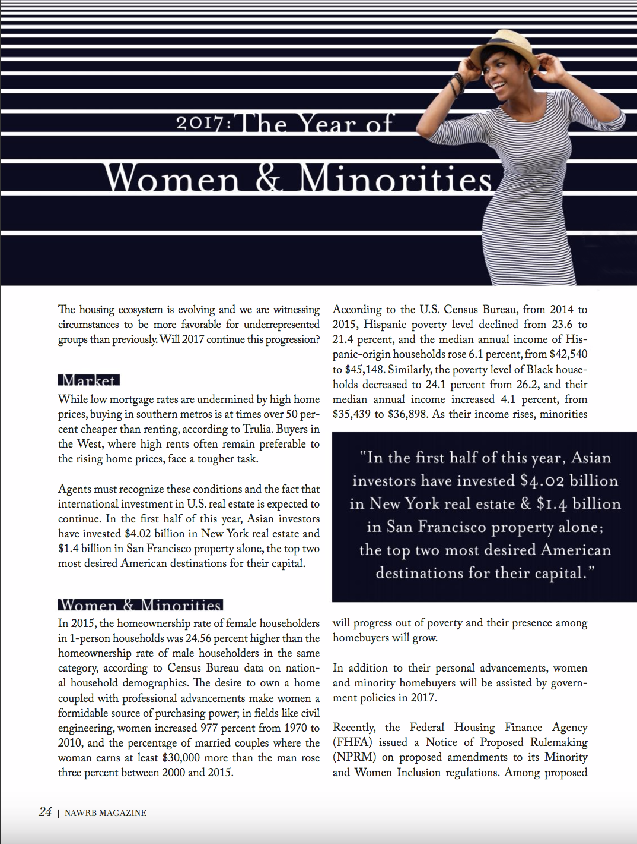
Homeowners:
In 2015, the homeownership rate of female householders in 1-person households was 24.56% higher than the homeownership rate of male households in the same category.

Slide 28
Join NAWRB at the front lines of gender equality, or
Be a Strategic Partner!
www.NAWRB.com
(949) 559-9800

